Slide 1

Twitter Sentiment Analysis
Subject : Final Year Project
Class : B.E - IV C.S.E
Guide : Dr. Mamta C. Padole
Name Seat No.
Rohan shah 804033
Keval.Kulkarni 804013
Meet Suthar 804036
Department of Computer Science & Engineering
Faculty of Technology & Engineering
The Maharaja Sayajirao University of Baroda
April-2020

Slide 2

Sentiment Analysis
Sentiment analysis is the process of determining whether a
piece is positive or negative or neutral.
Also referred to as opinion mining,it makes our goal to determine
whether the data(tweet) is positive,negative or neutral.

Slide 3
Importance
Movie: is this review positive or negative?
Products: what do people think about the new iPhone?
Public sentiment: how is consumer confidence? Is despair increasing?
Politics: what do people think about this candidate or issue?
Prediction: predict election outcomes or market trends from sentiment

Slide 4
Why Twitter Data?
Popular microblogging site
Short text message of 140 characters
240+ millions active users
500 million tweets generated everyday
Twitter audience varies from common man to celebraties
Users often discuss current affair and Share personal views on
Various objects
Tweets are small in length and hence unambigous

Slide 5
Live Streaming of Tweets
Using twitter api for fetching live tweets
tweepy package in python
Tweets that are from India
State-wise
Specific location

Slide 6
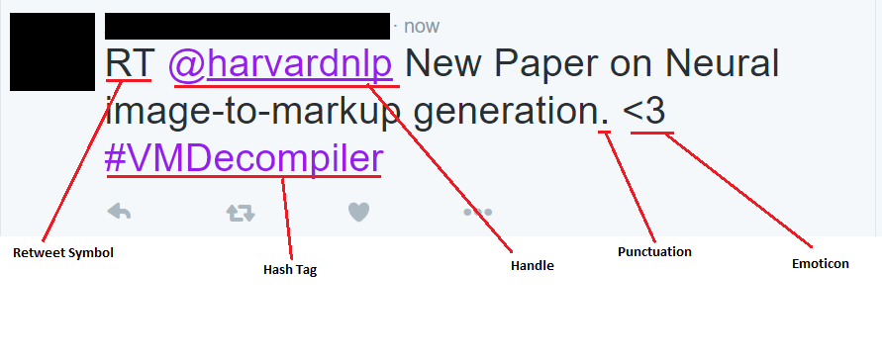
Real Tweets

Slide 7
Pre-Processing
Regular expression for removing unnecessary words
Removing RT retweets symbol
Removing @ mentions
Removing # hashtags
Removing Social media handles
Removing punctuations
Re package in python

Slide 8
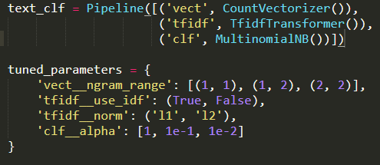
Modeling
Accuracy using Different algorithm
MultinomialNB :: 85%
SVM :: 83%

Slide 9
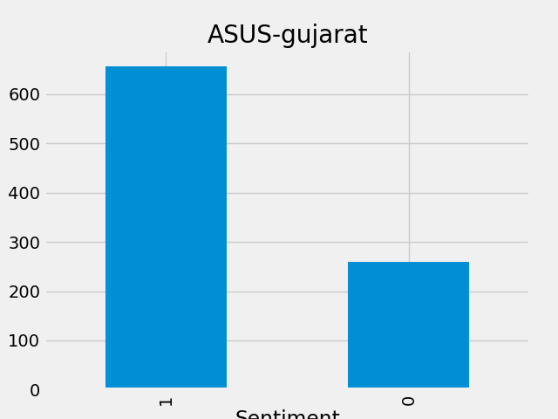
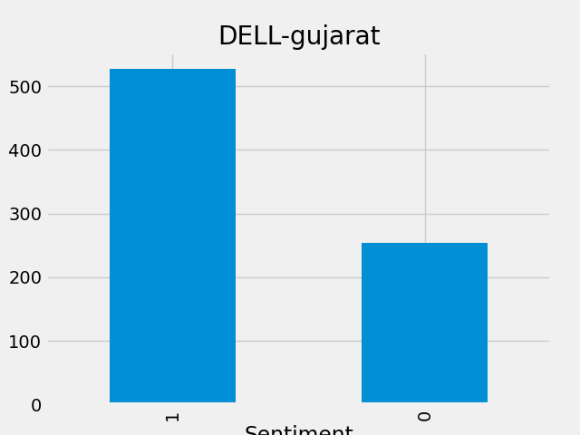
Sentiment to specific keyword

Slide 10
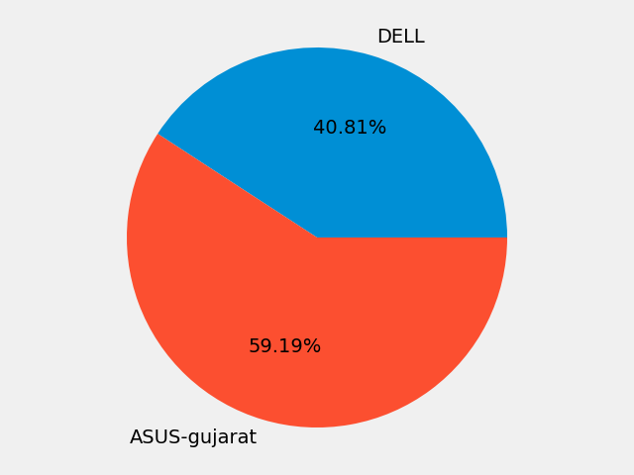
Comparison Using Pie-Chart

Slide 11

Screenshots

Slide 12
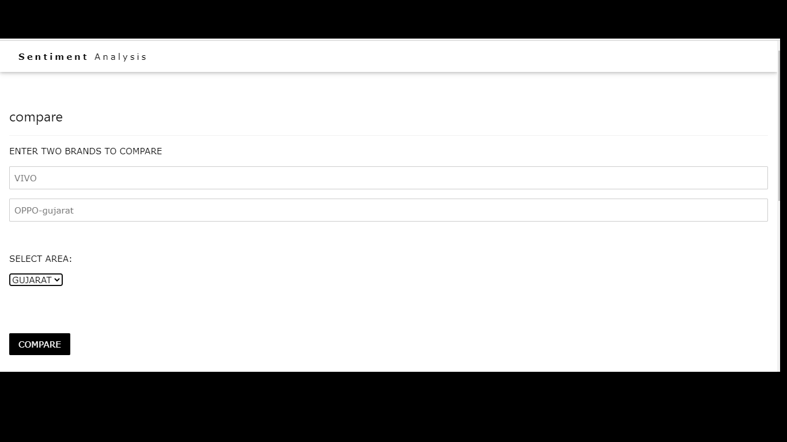

Slide 13
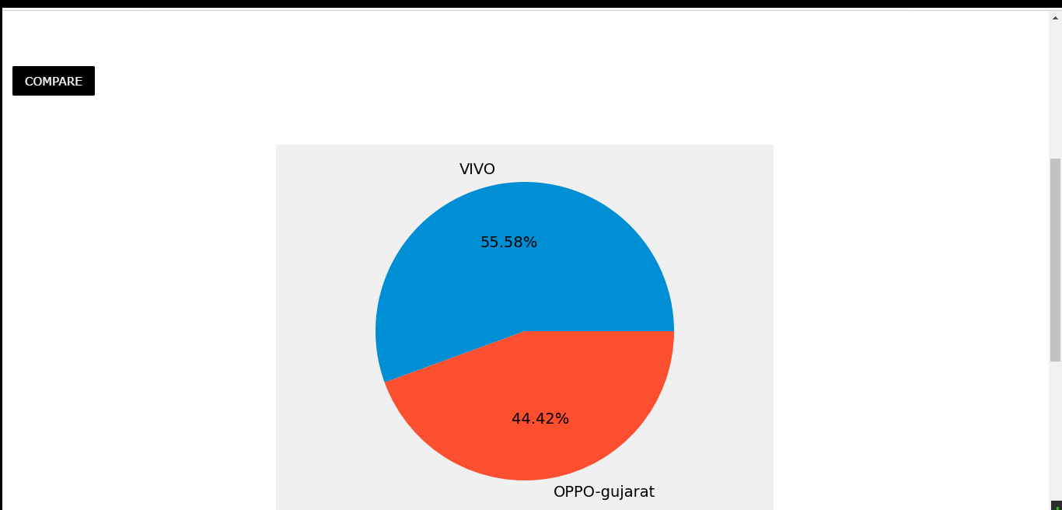

Slide 14
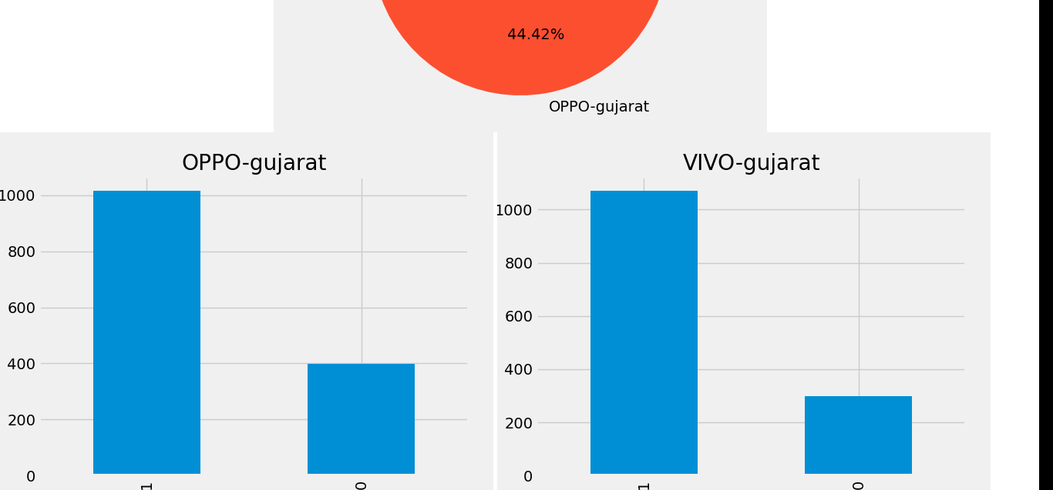

Slide 15
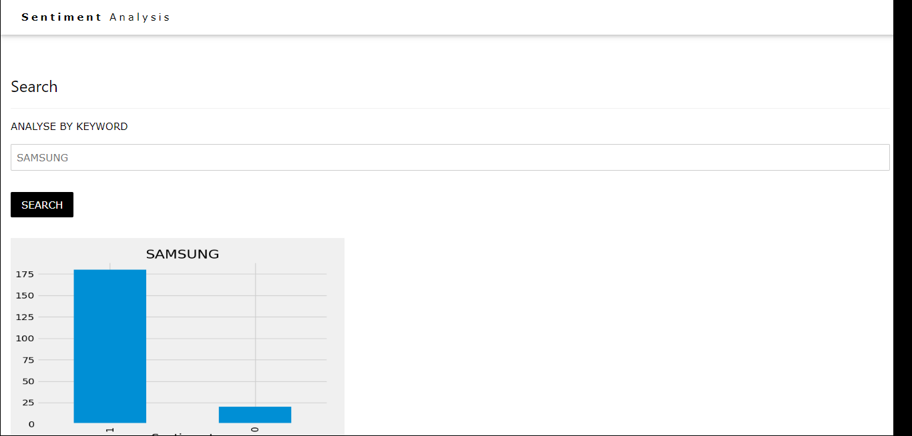

Slide 16
THANK YOU

